Slide 1
Slide 6
03/11/2020
Number of Ideas vs Number of words
Bibek Khadayat

Slide 2
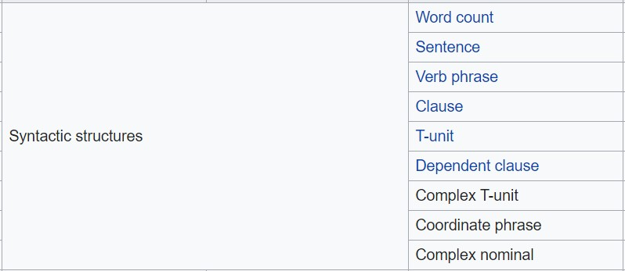
L2 Syntactic Complexity Analyzer Task: Implementation of Number of idea vs number of words https://en.wikipedia.org/wiki/L2_Syntactic_Complexity_Analyzer
Is computational tool used to produce syntactic complexity indices of English language text.
Is used for linguistics field.

Slide 3
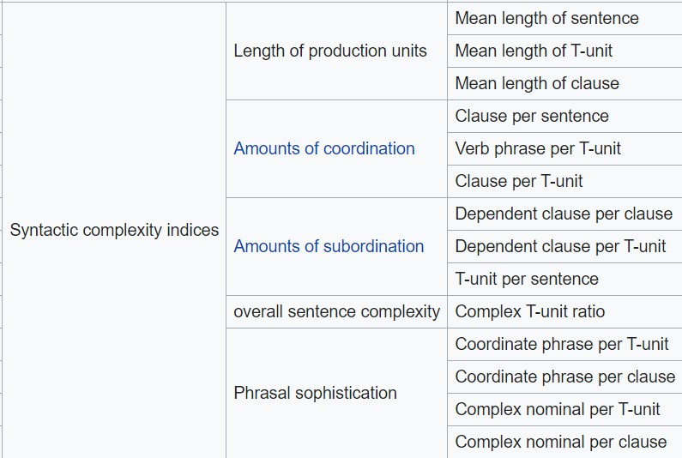

Slide 4
CPIDR(Computerized Propositional Idea Density Rater) Task: Implementation of Number of idea vs number of words https://www.ncbi.nlm.nih.gov/pmc/articles/PMC2423207/
Determine propositional idea density on basic of part-of-speech tag.
Propositional idea density can be approximated by the number of verbs , adjective, adverb , prepositions and conjunctions divided by the total number of word.
Use Monty Lingua.

Slide 5
Textstat task : Readability https://pypi.org/project/textstat/
Is a python package to calculate statistics of text
Used for readability, complexity and grade level of text.
List of function
Syllable count
Lexicon count
Sentence count
Flesch reading Ease Formula
Flesch-Kincaid grade level
Fog Scale
SMOG index
Automated Readability Index
Coleman_Liau Index
Linsear Write Formula
Dale-chall readability Score

Slide 6
Python Wrapper for Stanford OpenIE task : Triples extraction https://pypi.org/project/stanford-openie/
Extract structured relation triples from text
Unofficial cross platform python wrapper for state-of-art information extraction library

